Slide 1
CodeBig
Spark Ideas

Slide 2




CodeBig Team
Sejal Chauhan
University of Wisconsin-Madison
Lyujia Zhang (Chloe)
Columbia University in the City of New York
Shubhi Rani
Stony Brook University
Wan Chen
University of Illinois at Urbana Champaign

Slide 3

Spark is Coming

Slide 4
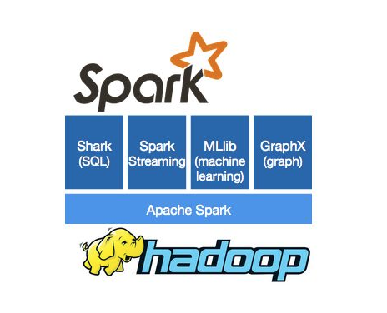
What is Spark?
Apache Spark™ is a fast and general engine for large-scale data processing
DAG Execution Engine
Cyclic Dataflow
In-memory caching and faster execution
Using RDD(Resilient Distributed Datasets)
Supports applications written in
Java
Python
Scala
Over 80 operators to facilitate parallel apps
http://spark.apache.org/images/spark-logo-trademark.png

Slide 5
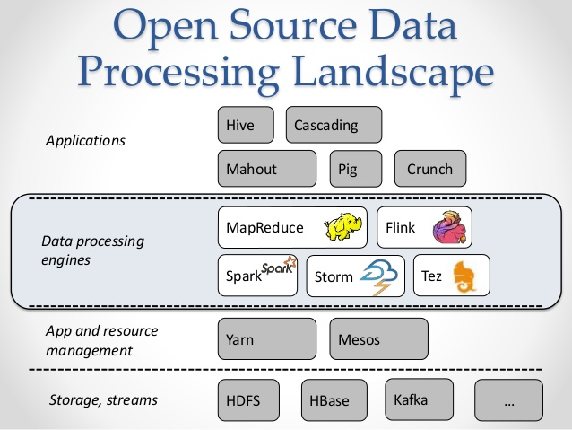
Architecture Overview
Components
Applications
Hive
Data Processing Engines
Spark
App and resource management
YARN
https://media.licdn.com/mpr/mpr/shrinknp_800_800/AAEAAQAAAAAAAAbEAAAAJDMwMDUxZTkwLTA1MjMtNDkxZS05NTU1LTA2NjNjOGQxYWIwNg.jpg

Slide 6
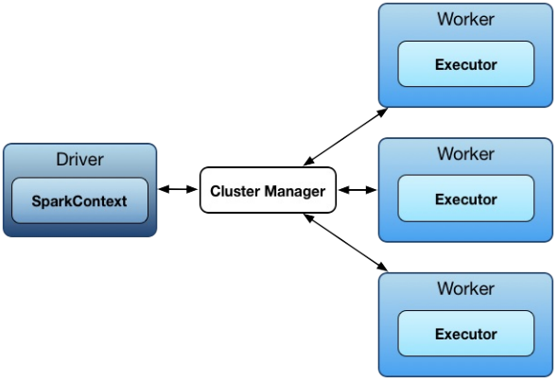
Spark Architecture (master/slave architecture)
SparkEnv
TaskScheduler
DAGScheduler
Notes:
Driver talks to master (single coordinator manages workers).
Driver and the executors run in their own Java processes, can be run on same (horizontal cluster) or separate machines (vertical cluster).
Driver splits a Spark application into tasks and schedules them to run on executors.
A driver coordinates workers and overall execution of tasks.
Master is a running Spark instance that connects to a cluster manager for resources.
The master acquires cluster nodes to run executors.
Workers/slaves are running Spark instances where executors live to execute tasks. (compute nodes)

Slide 7
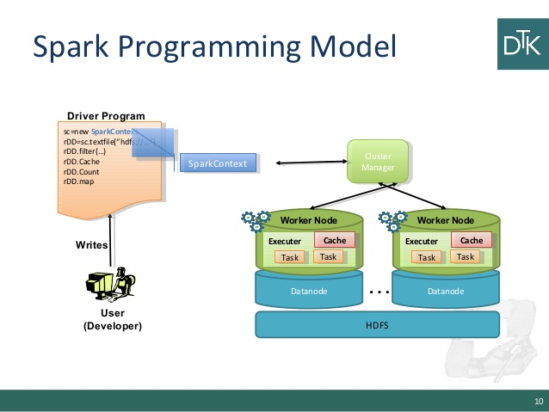
Why Spark?
Low-level Optimizations
DAG( directed acyclic graph) of computation stages
Lazy evaluation(Postpone any processing until really required for action)
Low-latency iterative workloads
Cache intermediate data in memory for faster model building and training
Machine Learning algorithms require plenty of iterations before convergence
Graph algorithms traverse all nodes and edges
http://image.slidesharecdn.com/6-150108024847-conversion-gate02/95/scala-and-spark-10-638.jpg?cb=1420685361

Slide 8
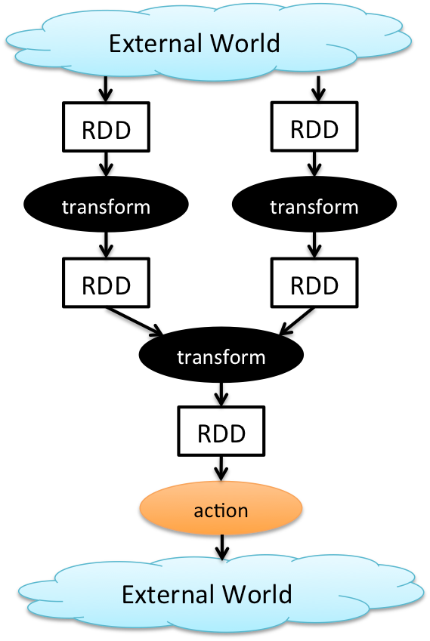
Programming Paradigm and Basic Concepts
Distribute a large data set on multiple nodes
Map functions row by row
Group data by a key
Perform aggregate operations
http://1.bp.blogspot.com/-n4yvEQU--bQ/VHktMl5yzSI/AAAAAAAABI8/rmDb69CpgUE/s1600/p1.png

Slide 9
Basic Concepts
Resilient Distributed Datasets RDD
Input, output, and intermediate data in-memory caching → apply actions to RDD to return values → transformations to return new RDD.
Transformation:
Map - rdd.map for adding a constant for each item
Filter - rdd.filter for items satisfying a condition
reduceByKey - rdd.reduceByKey for reduction within a group using a key
Action:
Collect - rdd.collect for printing items
Reduce - rdd.reduce for summation/mean

Slide 10
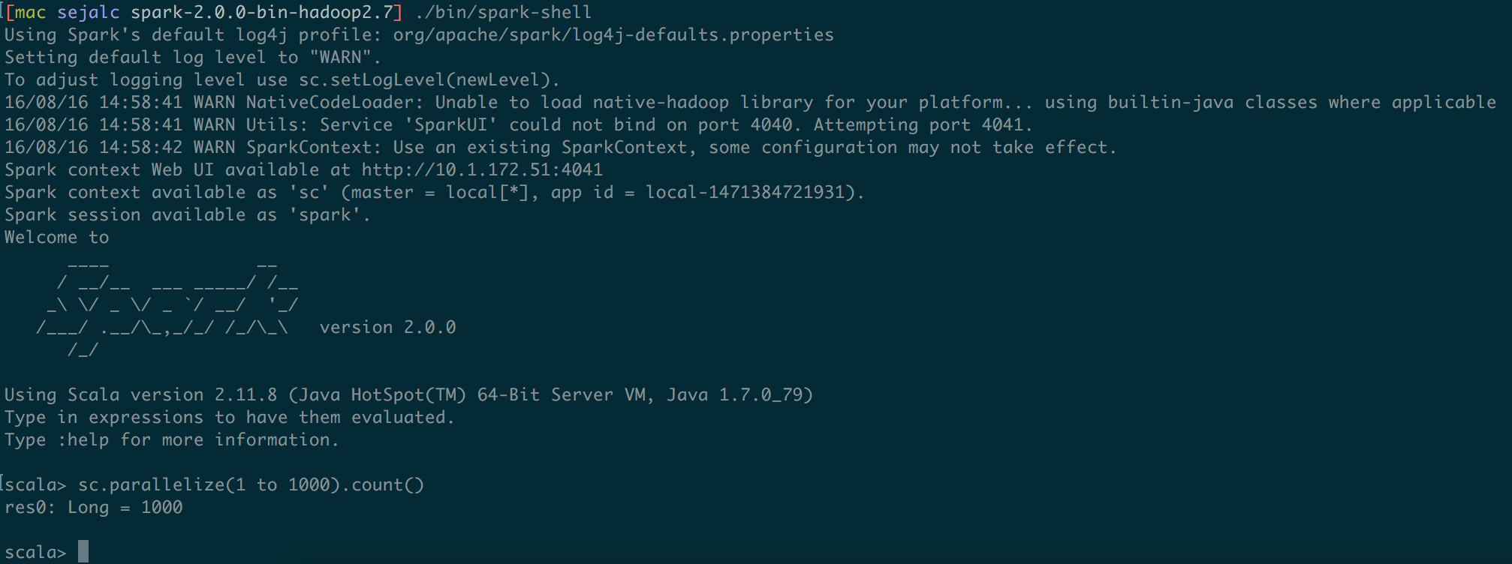
Scala Interactive Interface

Slide 11
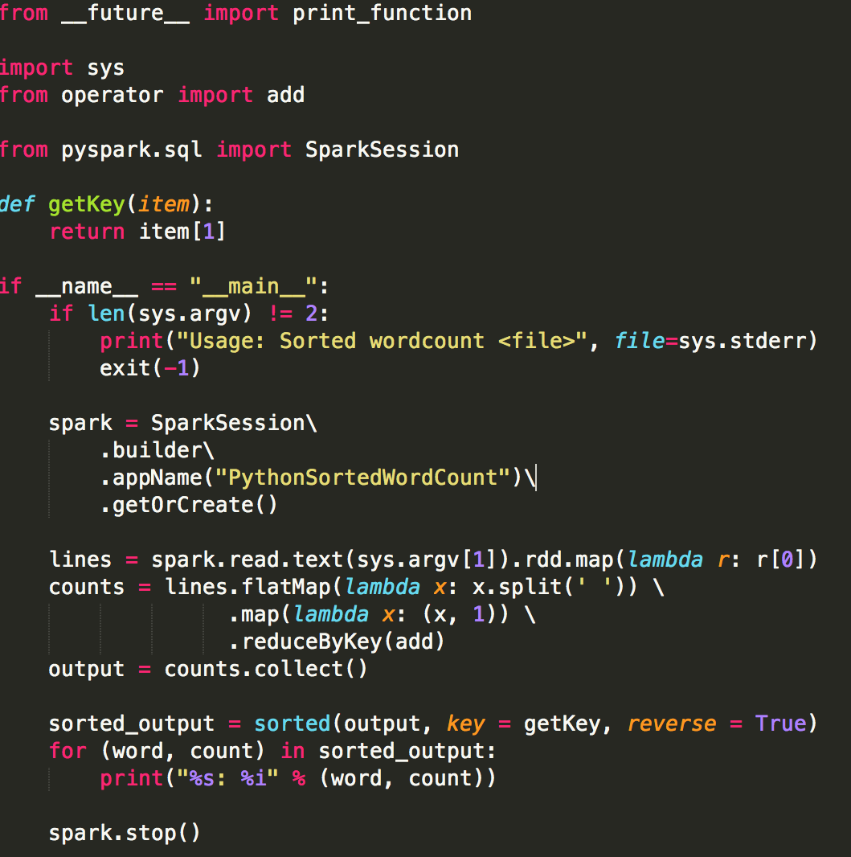

Spark Exercises
Three step Sorted Word Count:
Map the words
Reduce
Collect the words in the sorted manner
SortedWordCount Demo: https://youtu.be/GwWbScFam0I
PiDemo: https://youtu.be/9kI9lQorpMY

Slide 12
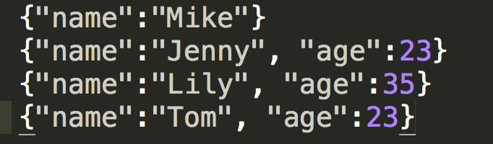
Spark SQL Example
Given a dataset of employees list with their names and ages, do queries on it with Spark SQL as following:
Print out the data frame generated by reading the json file
Print out attribute types by printing schema
Show all names listed in the dataset
Count number of employees at each age
Show all names of employees with age younger than 30
Employee.json
basic_dataframe.py (Github link) https://github.com/CodeChix-OpenSource/CodeChix-Technical-Curriculums/tree/master/VMware-CodeHouse/CodeBig/src/basic_daataframe.py
Demo (Youtube link) https://youtu.be/CRJE7-CBT1s

Slide 13
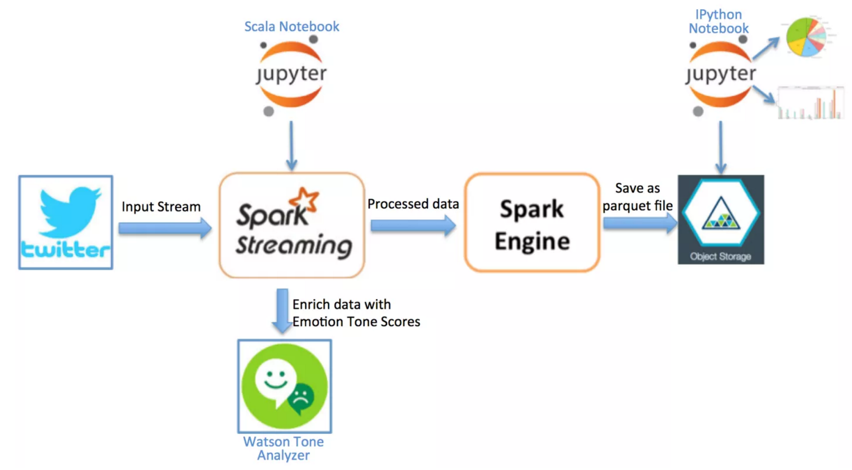
Spark Streaming
Spark Streaming example from IBM’s project - Sentiment Analysis of Twitter Hashtags
https://developer.ibm.com/clouddataservices/sentiment-analysis-of-twitter-hashtags/

Slide 14
MLlib
MLlib is Apache Spark’s scalable machine learning library
MLlib incorporates following algorithms
Classification : Logistic regression, Naive Bayes
Regression : Linear Regression
Collaborative filtering : Alternative Least Sequence
Clustering: K-means
Decomposition: SVD, PCA
Data scientists can use both Python and R to use Spark

Slide 15
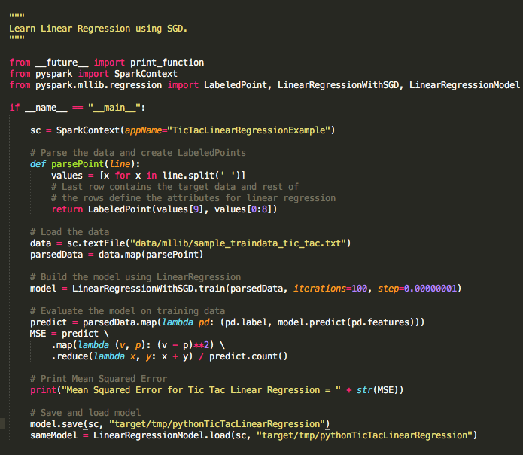
Tic Tac Linear Regression Algorithm

Slide 16
Tic Tac Linear Regression Algorithm

Slide 17
Tic Tac Linear Regression Algorithm

Slide 18
Tic Tac Linear Regression Algorithm

Slide 19
Demo for Tic Tac
You can find demo link for Tic Tac Linear regression python program
YouTube
https://youtu.be/rmlyCOtpew8
Github Link
GitHub
https://github.com/CodeChix-OpenSource/CodeChix-Technical-Curriculums/tree/master/VMware-CodeHouse/CodeBig/src/tic_tac_linear_reg.py

Slide 20
Ongoing and Future Work
GraphX for graph theory, relationship mapping, and data stream processing
Collaborative Filtering: ALS(Alternating least squares)
Multi clustering across different systems

Slide 21
Where do I apply this amazing stuff?
Movie Recommendation - MLlib Collaborative Filtering
Flight Scheduling - MLlib
Data Streaming - Amazon product recommendation

Slide 22
References
https://spark.apache.org/downloads.html
http://genomegeek.blogspot.com/2014/11/how-to-install-apache-spark-on-mac-os-x.html
https://spark.apache.org/docs/latest/graphx-programming-guide.html
https://aws.amazon.com/emr/details/spark/
https://aws.amazon.com/blogs/aws/new-apache-spark-on-amazon-emr/
http://stackoverflow.com/questions/27440377/unable-to-convert-spark-rdd-to-schema-rdd
https://rpubs.com/wendyu/sparkr
http://spark.apache.org/docs/latest/mllib-collaborative-filtering.html
https://spark.apache.org/docs/1.2.0/programming-guide.html

Slide 23
Summary
Thank you for attending the brief session on Spark.
There are humongous real life problems that can be solved much faster using Spark
Spark Ideas and Code Big!!

